Slide 1
Computer Networks: A Systems Approach, 5e
Larry L. Peterson and Bruce S. Davie
01 Foundation (Chapter 1)
This chapter describes applications and their requirements to set the stage for the rest of the material.
Copyright © 2010, Elsevier Inc. All rights Reserved

Slide 2
Outline
Applications
Requirements
Network Architectures
Performance Metrics
Internet History
Socket Programming

Slide 3
Applications
Most people know about the Internet (a computer network) through applications
World Wide Web
Email
Online Social Network
Streaming Audio Video
File Sharing
Instant Messaging
…

Slide 4

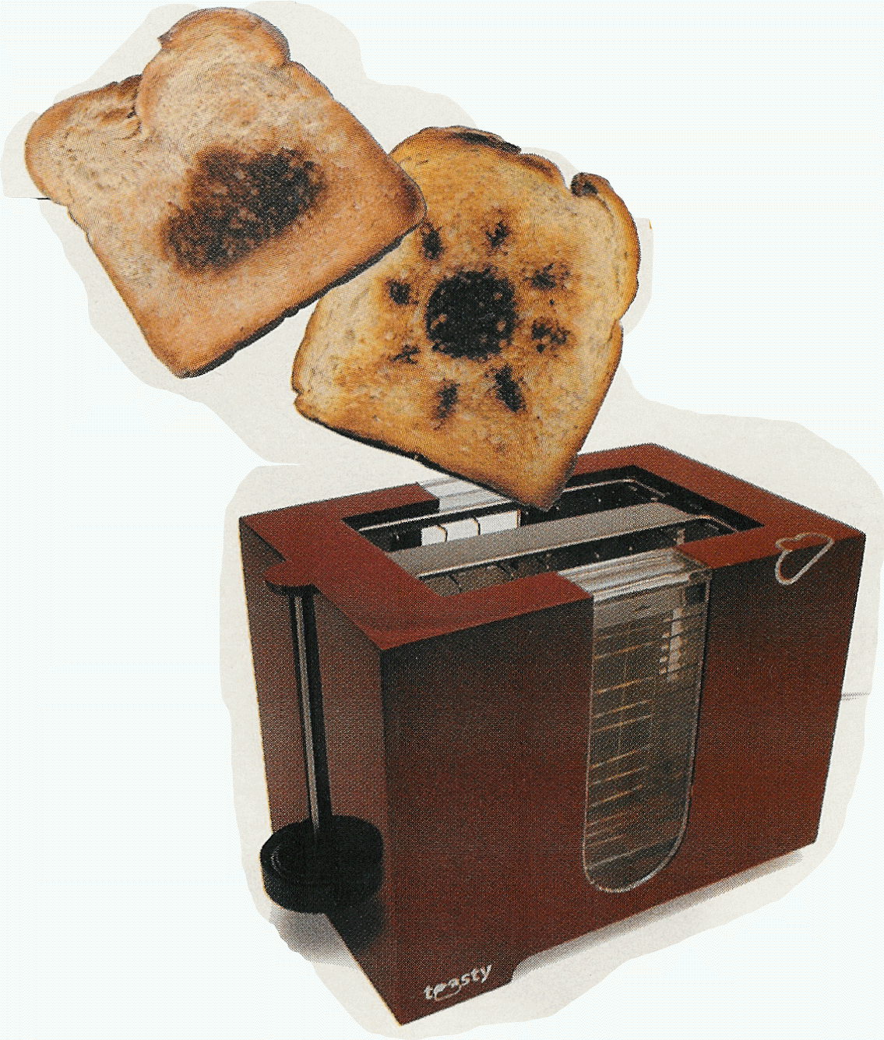



“Fun” Internet Appliances
Web-enabled toaster +
weather forecaster
IP picture frame
http://www.ceiva.com/
Tweet-a-watt:
monitor energy use
Slingbox: watch,
control cable TV remotely
Internet
refrigerator
Internet phones

Slide 5
Application Protocol
URL
Uniform resource locater
http://www.cs.princeton.edu/~llp/index.html
HTTP
Hyper Text Transfer Protocol
TCP
Transmission Control Protocol
17 messages for one URL request
6 to find the IP (Internet Protocol) address
3 for connection establishment of TCP
4 for HTTP request and reply
Request: I got your request and I will send the data
Reply: Here is the data you requested; I got the data
4 messages for tearing down TCP connection

Slide 6
Multi-Level Tasks
Application Programmer
List the services that his application needs: delay bounded delivery of data
Network Designer
Design a cost-effective network with sharable resources
Network Provider
List the characteristics of a system that is easy to manage

Slide 7
Internet structure: network of networks
End systems connect to Internet via access ISPs (Internet Service Providers)
Residential, company and university ISPs
Access ISPs in turn must be interconnected.
So that any two hosts can send packets to each other
Resulting network of networks is very complex
Evolution was driven by economics and national policies
Let’s take a stepwise approach to describe current Internet structure

Slide 8
Internet structure: network of networks
Question: given millions of access ISPs, how to connect them together?
…
…
access
net
access
net
access
net
access
net
access
net
access
net
access
net
…
…
access
net
access
net
access
net
access
net
access
net
access
net
…
access
net
access
net
…
access
net

Slide 9
Internet structure: network of networks
Option: connect each access ISP to every other access ISP?
…
…
access
net
access
net
access
net
access
net
access
net
…
…
access
net
access
net
…
connecting each access ISP to each other directly doesn’t scale: O(N²) connections.
…
…
access
net
access
net
…
access
net
access
net
access
net
…
access
net
…
access
net
access
net
…
access
net

Slide 10
Internet structure: network of networks
Option: connect each access ISP to a global transit ISP? Customer and provider ISPs have economic agreement.
…
…
access
net
access
net
access
net
access
net
access
net
access
net
access
net
…
…
global ISP
access
net
access
net
access
net
access
net
access
net
access
net
…
access
net
access
net
…
access
net

Slide 11
Internet structure: network of networks
But if one global ISP is viable business, there will be competitors ….
…
…
access
net
access
net
access
net
access
net
access
net
access
net
access
net
ISP A
…
…
access
net
ISP B
access
net
ISP C
access
net
access
net
access
net
access
net
…
access
net
access
net
…
access
net

Slide 12
Internet structure: network of networks
But if one global ISP is viable business, there will be competitors …. which must be interconnected
Internet exchange point
…
…
access
net
access
net
access
net
access
net
access
net
IXP
access
net
access
net
ISP A
…
…
IXP
access
net
access
net
ISP B
ISP C
access
net
access
net
peering link
access
net
access
net
…
access
net
access
net
…
access
net

Slide 13
Internet structure: network of networks
… and regional networks may arise to connect access nets to ISPS
…
…
access
net
access
net
access
net
access
net
access
net
IXP
access
net
access
net
ISP A
…
…
IXP
access
net
access
net
ISP B
ISP C
access
net
access
net
access
net
regional net
access
net
…
access
net
access
net
…
access
net

Slide 14
Internet structure: network of networks
… and content provider networks (e.g., Google, Microsoft, Akamai) may run their own network, to bring services, content close to end users
…
…
access
net
access
net
access
net
access
net
access
net
IXP
access
net
access
net
ISP A
…
…
Content provider network
IXP
access
net
access
net
ISP B
ISP B
access
net
access
net
access
net
regional net
access
net
…
access
net
access
net
…
access
net

Slide 15
Internet structure: network of networks
Tier 1 ISP
Tier 1 ISP
Google
IXP
IXP
IXP
Regional ISP
Regional ISP
access
ISP
access
ISP
access
ISP
access
ISP
access
ISP
access
ISP
access
ISP
access
ISP
at center: small # of well-connected large networks
“tier-1” commercial ISPs (e.g., Level 3, Sprint, AT&T, NTT), national & international coverage
content provider network (e.g, Google): private network that connects it data centers to Internet, often bypassing tier-1, regional ISPs

Slide 16
Tier-1 ISP: e.g., Sprint
POP: point-of-presence
to/from backbone
peering
…
…
…
…
…
to/from customers

Slide 17
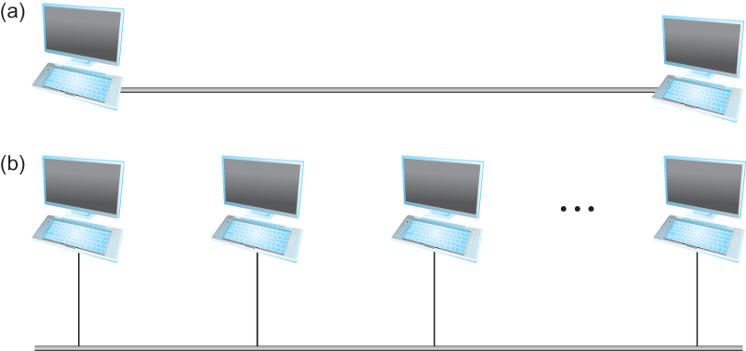
Connectivity
Need to understand the following terminologies
Link
Nodes
Point-to-point
Multiple access
Switched Network
Circuit Switched
Packet Switched
Packet, message
Store-and-forward
Point-to-point
Multiple access

Slide 18
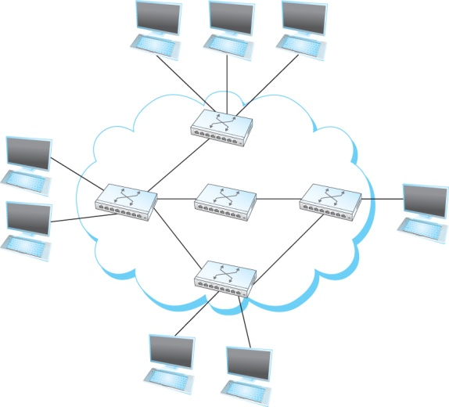
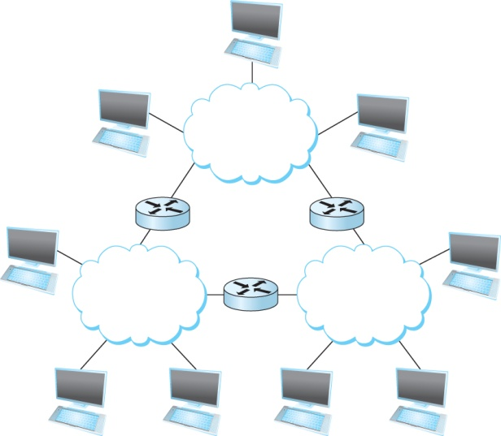
Connectivity
Terminologies (contd.)
Cloud
Hosts
Switches
internetwork
Router/gateway
Host-to-host connectivity
Address
Routing
Unicast/broadcast/multicast
(a)
(b)
A switched network
Interconnection of networks

Slide 19
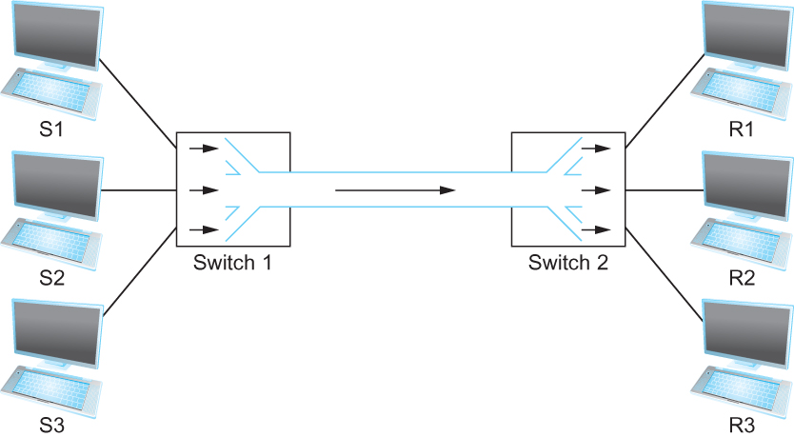
Cost-Effective Resource Sharing
Resource: links and nodes
How to share a link?
Multiplexing
Eg. Time/Frequency-division Multiplexing, Statistical Multiplexing
Multiplexing multiple logical flows over a single physical link

Slide 20
Resource Sharing: Circuit Switching
Example:
FDM
4 users
frequency
time
TDM
frequency
time

Slide 21
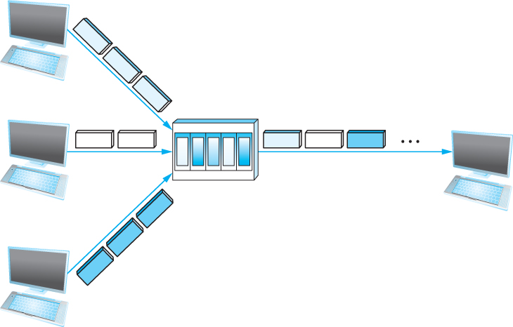
Cost-Effective Resource Sharing
Statistical Multiplexing
Data is transmitted based on demand of each flow.
What is a flow?
Packets vs. Messages
FIFO, Round-Robin, Priorities (Quality-of-Service (QoS))
Congested?
LAN, MAN, WAN
A switch multiplexing packets from multiple sources onto one shared link

Slide 22
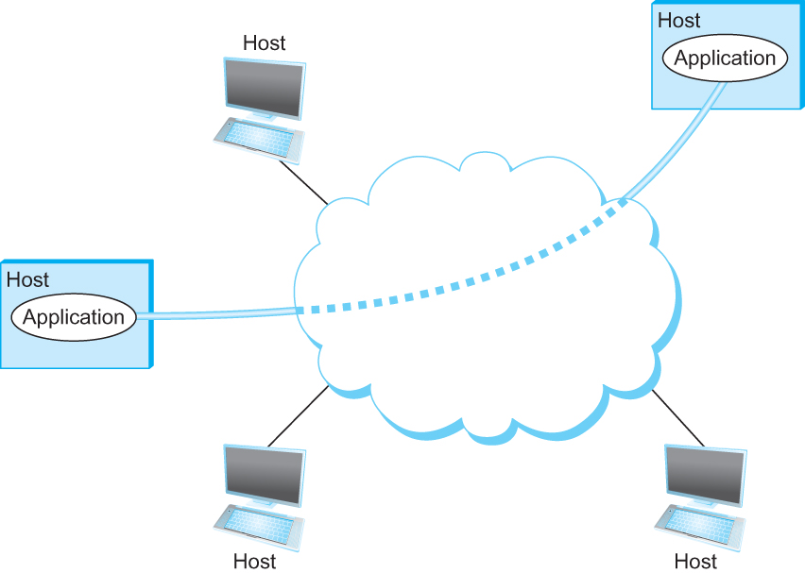
Support for Common Services
Logical Channels
Application-to-Application communication path or a pipe
Process communicating over an abstract channel

Slide 23
Common Communication Patterns
Client/Server
Two types of communication channel
Request/Reply Channels
Message Stream Channels

Slide 24
Practical Issues - Reliability
Bits are lost
Bit errors (1 to a 0, and vice versa)
Burst errors – several consecutive errors
Packets are lost (congestion)
Links and Node failures
Messages are delayed
Messages are delivered out-of-order
Third parties eavesdrop
Network should hide the errors

Slide 25
What’s a protocol?
human protocols:
“Excuse me?”
“I have a question”
introductions
… specific msgs sent
… specific actions taken when msgs received, or other events
network protocols:
machines rather than humans
all communication activity in Internet governed by protocols
protocols define format, semantics, order of msgs sent and received among network entities, and actions taken on msg transmission, receipt

Slide 26



What’s a protocol?
a human protocol and a computer network protocol:
Hi
TCP connection
request
Hi
TCP connection
response
Got the
time?
Get http://www.awl.com/kurose-ross
2:00
<file>
time
Q: other human protocols?

Slide 27
Protocols
Protocol defines the interfaces between the layers in the same system and with the layers of peer system
Building blocks of a network architecture
Each protocol object has two different interfaces
service interface: operations on this protocol
peer-to-peer interface: messages exchanged with peer
Term “protocol” is overloaded
specification of peer-to-peer interface
module that implements this interface

Slide 28
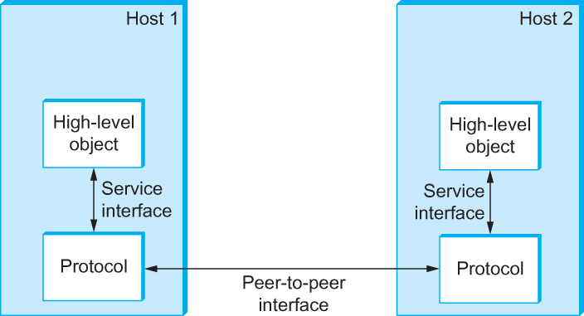
Interfaces
Service and Peer Interfaces

Slide 29
Protocols
Protocol Specification: prose, pseudo-code, state transition diagram
Interoperable: when two or more protocols that implement the specification accurately
Internet standards
IETF: Internet Engineering Task Force
RFC: Request For Comments

Slide 30
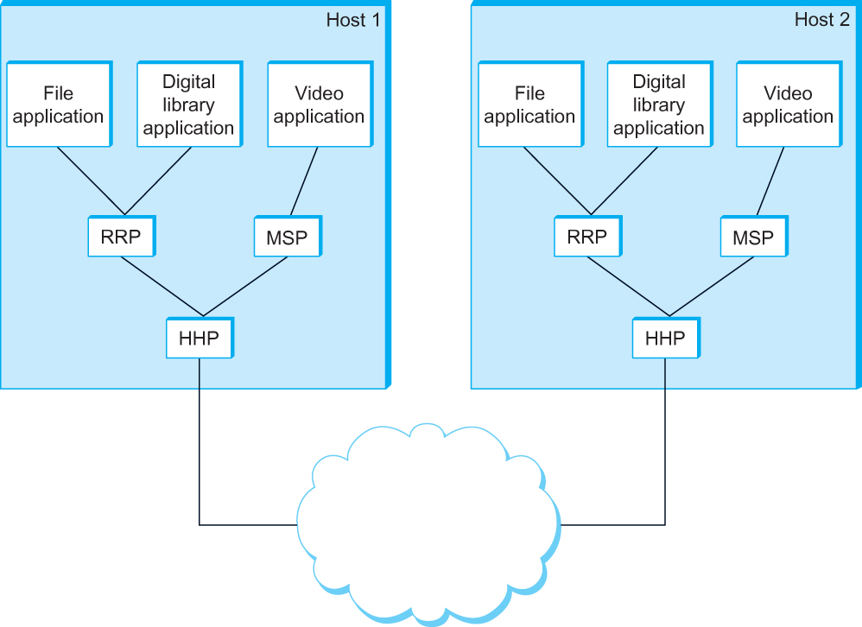
Protocol Graph
Example of a protocol graph
nodes are the protocols and links the “depends-on” relation

Slide 31
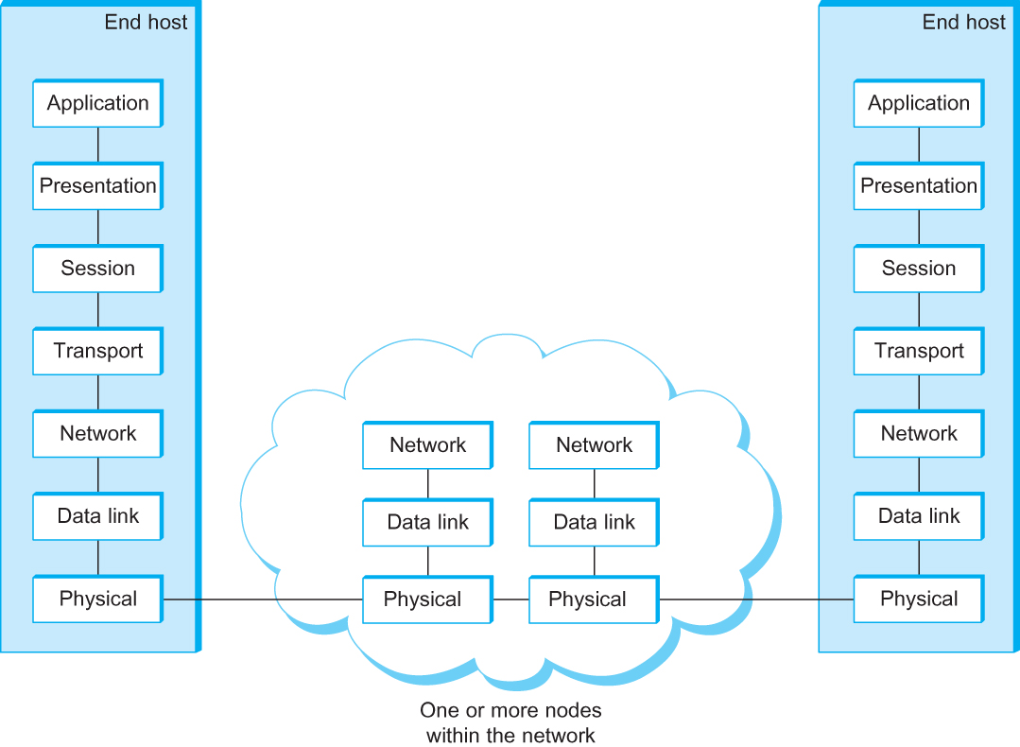
OSI Architecture
The OSI 7-layer Model
OSI – Open Systems Interconnection

Slide 32
Internet protocol stack
application: supporting network applications
FTP, SMTP, HTTP
transport: process-process data transfer
TCP, UDP
network: routing of datagrams from source to destination
IP, routing protocols
link: data transfer between neighboring network elements
Ethernet, 802.11 (WiFi), PPP
physical: bits “on the wire”
application
transport
network
link
physical

Slide 33
ISO/OSI reference model
presentation: allow applications to interpret meaning of data, e.g., encryption, compression, machine-specific conventions
session: synchronization, checkpointing, recovery of data exchange
Internet stack “missing” these layers!
these services, if needed, must be implemented in application
needed?
application
presentation
session
transport
network
link
physical

Slide 34
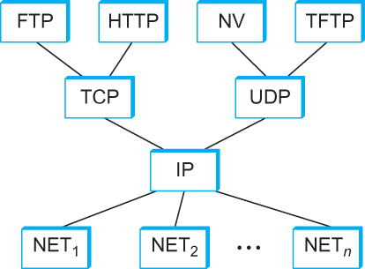
Internet Architecture
Internet Protocol Graph

Slide 35
Internet Architecture
Defined by IETF
Three main features
Does not imply strict layering. The application is free to bypass the defined transport layers and to directly use IP or other underlying networks
An hour-glass shape, IP serves as the focal point for the architecture
In order for a new protocol to be officially included in the architecture, there needs to be both a protocol specification and at least one (and preferably two) representative implementations of the specification

Slide 36
Encapsulation
source
message
M
application
transport
network
link
physical
segment
H_{t}
M
H_{t}
datagram
H_{n}
H_{n}
H_{t}
M
frame
H_{l}
H_{n}
H_{t}
M
link
physical
switch
destination
H_{n}
H_{t}
M
network
link
physical
M
application
transport
network
link
physical
H_{l}
H_{n}
H_{t}
M
H_{n}
H_{t}
M
H_{t}
M
H_{n}
H_{t}
M
H_{l}
H_{n}
H_{t}
M
router

Slide 37



Packet-switching: store-and-forward
L bits
per packet
source
3
2
1
R bps
R bps
destination
takes L/R seconds to transmit (push out) L-bit packet into link at R bps
store and forward: entire packet must arrive at router before it can be transmitted on next link
one-hop numerical example:
L = 7.5 Mbits
R = 1.5 Mbps
one-hop transmission delay = 5 sec
end-end delay = 2L/R (assuming zero propagation delay)
more on delay shortly …

Slide 38
Packet Switching: queueing delay, loss
R = 100 Mb/s
C
A
D
R = 1.5 Mb/s
B
E
queue of packets
waiting for output link
queuing and loss:
If arrival rate (in bits) to link exceeds transmission rate of link for a period of time:
packets will queue, wait to be transmitted on link
packets can be dropped (lost) if memory (buffer) fills up

Slide 39
Two key network-core functions
forwarding: move packets from router’s input to appropriate router output
routing: determines source-destination route taken by packets
routing algorithms
routing algorithm
local forwarding table
header value
output link
0100
0101
0111
1001
3
2
2
1
1
3
2
0111
dest address in arriving
packet’s header

Slide 40
Alternative : circuit switching
end-end resources allocated to, reserved for “call” between source & dest:
In diagram, each link has four circuits.
call gets 2nd circuit in top link and 1st circuit in right link.
dedicated resources: no sharing
circuit-like (guaranteed) performance
circuit segment idle if not used by call (no sharing)
Commonly used in traditional telephone networks

Slide 41
Circuit switching: FDM vs.TDM
Example:
FDM
4 users
frequency
time
TDM
frequency
time
Notes:
Two simple multiple access control techniques.
Each mobile’s share of the bandwidth is divided into portions for the uplink and the downlink. Also, possibly, out of band signaling.
As we will see, used in AMPS, GSM, IS-54/136

Slide 42
Packet switching vs. circuit switching
packet switching allows more users to use network!
example:
1 Mb/s link
each user:
100 kb/s when “active”
active 10% of time
circuit-switching:
10 users
packet switching:
with 35 users, probability > 10 active at same time is less than .0004
N
users
…..
1 Mbps link
Q: how did we get value 0.0004?
Q: what happens if > 35 users ?

Slide 43
Packet switching vs. circuit switching
is packet switching a “slam dunk winner?”
great for bursty data
resource sharing
simpler, no call setup
excessive congestion possible: packet delay and loss
protocols needed for reliable data transfer, congestion control
Q: How to provide circuit-like behavior?
bandwidth guarantees needed for audio/video apps
still an unsolved problem
Q: human analogies of reserved resources (circuit switching) versus on-demand allocation (packet-switching)?

Slide 44
Performance Metrics
Delay
Bandwidth
Loss
Delay = Propagation + Transmit + Queue + Processing
Propagation = distance/speed of light
Transmit = size/bandwidth
One bit transmission => propagation is important
Large bytes transmission => bandwidth is important

Slide 45
How do loss and delay occur?
packets queue in router buffers
packet arrival rate to link (temporarily) exceeds output link capacity
packets queue, wait for turn
packet being transmitted (delay)
A
B
packets queueing (delay)
free (available) buffers: arriving packets
dropped (loss) if no free buffers

Slide 46
Four sources of packet delay
transmission
A
propagation
B
nodal
processing
queueing
d_{nodal} = d_{proc} + d_{queue} + d_{trans} + d_{prop}
d_{proc}: nodal processing
check bit errors
determine output link
typically < msec
d_{queue}: queueing delay
time waiting at output link for transmission
depends on congestion level of router

Slide 47
Four sources of packet delay
transmission
A
propagation
B
nodal
processing
queueing
d_{nodal} = d_{proc} + d_{queue} + d_{trans} + d_{prop}
d_{trans}: transmission delay:
L: packet length (bits)
R: link bandwidth (bps)
d_{trans} = L/R
d_{prop}: propagation delay:
d: length of physical link
s: propagation speed in medium (~2x10⁸ m/sec)
d_{prop} = d/s
d_{trans} and d_{prop}
very different
Notes:
47

Slide 48
Bandwidth
Bandwidth
Width of the frequency band
Number of bits per second that can be transmitted over a communication link
1 Mbps: 1 x 10⁶ bits/second ~= 1x2²⁰ bits/sec
1 x 10⁻⁶ seconds to transmit each bit or imagine that a timeline, now each bit occupies 1 micro second space.
On a 2 Mbps link the width is 0.5 micro second.
Smaller the width more will be transmission per unit time.

Slide 49
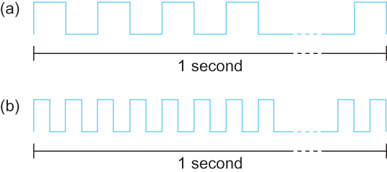
Bandwidth
Bits transmitted at a particular bandwidth can be regarded as having some width:
(a) bits transmitted at 1Mbps (each bit 1 μs wide);
(b) bits transmitted at 2Mbps (each bit 0.5 μs wide).

Slide 50
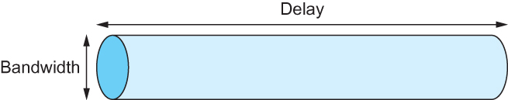
Delay X Bandwidth
We think the channel between a pair of processes as a hollow pipe
Latency (delay) length of the pipe and bandwidth the width of the pipe
Delay of 50 ms and bandwidth of 45 Mbps
50 x 10⁻³ seconds x 45 x 10⁶ bits/second
2.25 x 10⁶ bits = 280 KB data.
Network as a pipe

Slide 51
Delay X Bandwidth
Relative importance of bandwidth and latency depends on application
For large file transfer, bandwidth is critical
For small messages (HTTP, NFS, etc.), latency is critical
Variance in latency (jitter) can also affect some applications (e.g., audio/video conferencing)

Slide 52
Delay X Bandwidth
How many bits the sender must transmit before the first bit arrives at the receiver if the sender keeps the pipe full
Takes another one-way latency to receive a response from the receiver
If the sender does not fill the pipe—send a whole delay × bandwidth product’s worth of data before it stops to wait for a signal—the sender will not fully utilize the network

Slide 53
Delay X Bandwidth
Infinite bandwidth
RTT dominates
Throughput = TransferSize / TransferTime
TransferTime = RTT + 1/Bandwidth x TransferSize
Its all relative
1-MB file to 1-Gbps link looks like a 1-KB packet to 1-Mbps link

Slide 54
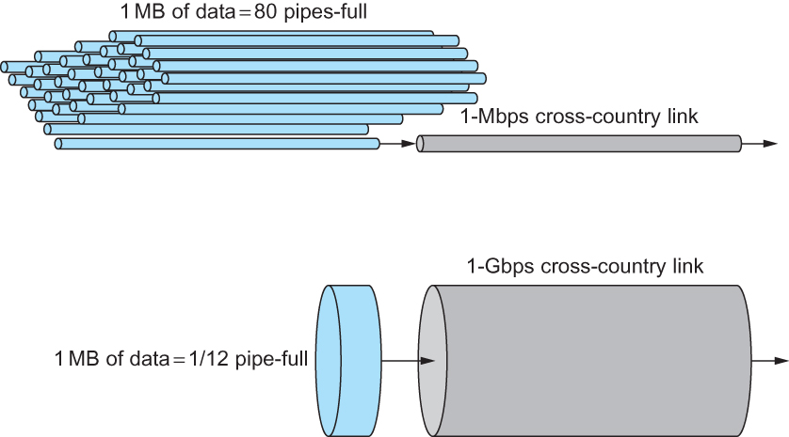
Relationship between bandwidth and latency
A 1-MB file would fill the 1-Mbps link 80 times,
but only fill the 1-Gbps link 1/12 of one time

Slide 55
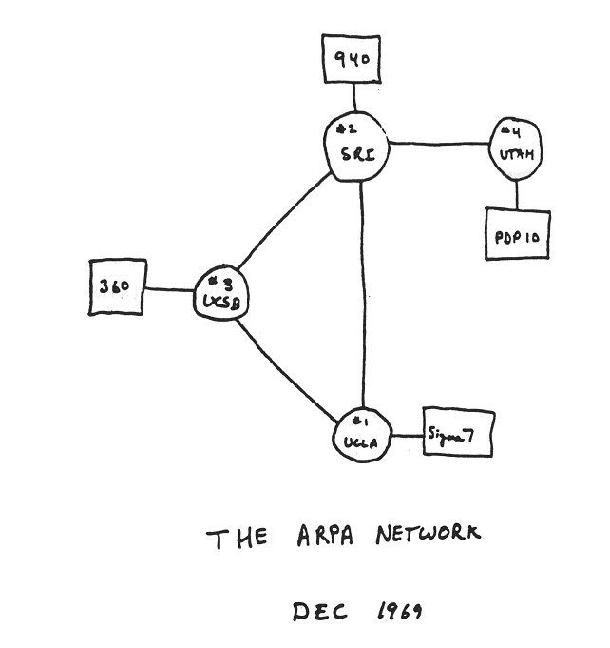
Internet history
1961-1972: Early packet-switching principles
1961: Kleinrock - queueing theory shows effectiveness of packet-switching
1964: Baran - packet-switching in military nets
1967: ARPAnet conceived by Advanced Research Projects Agency
1969: first ARPAnet node operational
1972:
ARPAnet public demo
NCP (Network Control Protocol) first host-host protocol
first e-mail program
ARPAnet has 15 nodes
Notes:
https://www.youtube.com/watch?v=2d7sPPlefok

Slide 56
Internet history
1972-1980: Internetworking, new and proprietary nets
1970: ALOHAnet satellite network in Hawaii
1974: Cerf and Kahn - architecture for interconnecting networks
1976: Ethernet at Xerox PARC
late70’s: proprietary architectures: DECnet, SNA, XNA
late 70’s: switching fixed length packets (ATM precursor)
1979: ARPAnet has 200 nodes
Cerf and Kahn’s internetworking principles:
minimalism, autonomy - no internal changes required to interconnect networks
best effort service model
stateless routers
decentralized control
define today’s Internet architecture

Slide 57
Internet history
1980-1990: new protocols, a proliferation of networks
1983: deployment of TCP/IP
1982: smtp e-mail protocol defined
1983: DNS defined for name-to-IP-address translation
1985: ftp protocol defined
1988: TCP congestion control
new national networks: Csnet, BITnet, NSFnet, Minitel
100,000 hosts connected to confederation of networks

Slide 58
Internet history
1990, 2000’s: commercialization, the Web, new apps
early 1990’s: ARPAnet decommissioned
1991: NSF lifts restrictions on commercial use of NSFnet (decommissioned, 1995)
early 1990s: Web
hypertext [Bush 1945, Nelson 1960’s]
HTML, HTTP: Berners-Lee
1994: Mosaic, later Netscape
late 1990’s: commercialization of the Web
late 1990’s – 2000’s:
more killer apps: instant messaging, P2P file sharing
network security to forefront
est. 50 million host, 100 million+ users
backbone links running at Gbps

Slide 59
Internet history
2005-present
~750 million hosts
Smartphones and tablets
Aggressive deployment of broadband access
Increasing ubiquity of high-speed wireless access
Emergence of online social networks:
Facebook: soon one billion users
Service providers (Google, Microsoft) create their own networks
Bypass Internet, providing “instantaneous” access to search, email, etc.
E-commerce, universities, enterprises running their services in “cloud” (eg, Amazon EC2)

Slide 60
Application Programming Interface
Interface exported by the network
Since most network protocols are implemented (those in the high protocol stack) in software and nearly all computer systems implement their network protocols as part of the operating system, when we refer to the interface “exported by the network”, we are generally referring to the interface that the OS provides to its networking subsystem
The interface is called the network Application Programming Interface (API)

Slide 61
Application Programming Interface (Sockets)
Socket Interface was originally provided by the Berkeley distribution of Unix
- Now supported in virtually all operating systems
Each protocol provides a certain set of services, and the API provides a syntax by which those services can be invoked in this particular OS

Slide 62
Socket
What is a socket?
The point where a local application process attaches to the network
An interface between an application and the network
An application creates the socket
The interface defines operations for
Creating a socket
Attaching a socket to the network
Sending and receiving messages through the socket
Closing the socket

Slide 63
Socket
Socket Family
PF_INET denotes the Internet family
PF_UNIX denotes the Unix pipe facility
PF_PACKET denotes direct access to the network interface (i.e., it bypasses the TCP/IP protocol stack)
Socket Type
SOCK_STREAM is used to denote a byte stream
SOCK_DGRAM is an alternative that denotes a message oriented service, such as that provided by UDP

Slide 64
Creating a Socket
int sockfd = socket(address_family, type, protocol);
The socket number returned is the socket descriptor for the newly created socket
int sockfd = socket (PF_INET, SOCK_STREAM, 0);
int sockfd = socket (PF_INET, SOCK_DGRAM, 0);
The combination of PF_INET and SOCK_STREAM implies TCP

Slide 65
Client-Serve Model with TCP
Server
Passive open
Prepares to accept connection, does not actually establish a connection
Server invokes
int bind (int socket, struct sockaddr *address,
int addr_len)
int listen (int socket, int backlog)
int accept (int socket, struct sockaddr *address,
int *addr_len)

Slide 66
Client-Serve Model with TCP
Bind
Binds the newly created socket to the specified address i.e. the network address of the local participant (the server)
Address is a data structure which combines IP and port
Listen
Defines how many connections can be pending on the specified socket

Slide 67
Client-Server Model with TCP
Accept
Carries out the passive open
Blocking operation
Does not return until a remote participant has established a connection
When it does, it returns a new socket that corresponds to the new established connection and the address argument contains the remote participant’s address

Slide 68
Client-Serve Model with TCP
Client
Application performs active open
It says who it wants to communicate with
Client invokes
int connect (int socket, struct sockaddr *address,
int addr_len)
Connect
Does not return until TCP has successfully established a connection at which application is free to begin sending data
Address contains remote machine’s address

Slide 69
Client-Serve Model with TCP
In practice
The client usually specifies only remote participant’s address and let’s the system fill in the local information
Whereas a server usually listens for messages on a well-known port
A client does not care which port it uses for itself, the OS simply selects an unused one

Slide 70
Client-Serve Model with TCP
Once a connection is established, the application process invokes two operation
int send (int socket, char *msg, int msg_len,
int flags)
int recv (int socket, char *buff, int buff_len,
int flags)

Slide 71
Example Application: Client
#include <stdio.h>
#include <sys/types.h>
#include <sys/socket.h>
#include <netinet/in.h>
#include <netdb.h>
#define SERVER_PORT 5432
#define MAX_LINE 256
int main(int argc, char * argv[])
{
FILE *fp;
struct hostent *hp;
struct sockaddr_in sin;
char *host;
char buf[MAX_LINE];
int s;
int len;
if (argc==2) {
host = argv[1];
}
else {
fprintf(stderr, "usage: simplex-talk host\n");
exit(1);
}

Slide 72
Example Application: Client
/* translate host name into peer’s IP address */
hp = gethostbyname(host);
if (!hp) {
fprintf(stderr, "simplex-talk: unknown host: %s\n", host);
exit(1);
}
/* build address data structure */
bzero((char *)&sin, sizeof(sin));
sin.sin_family = AF_INET;
bcopy(hp->h_addr, (char *)&sin.sin_addr, hp->h_length);
sin.sin_port = htons(SERVER_PORT);
/* active open */
if ((s = socket(PF_INET, SOCK_STREAM, 0)) < 0) {
perror("simplex-talk: socket");
exit(1);
}
if (connect(s, (struct sockaddr *)&sin, sizeof(sin)) < 0) {
perror("simplex-talk: connect");
close(s);
exit(1);
}
/* main loop: get and send lines of text */
while (fgets(buf, sizeof(buf), stdin)) {
buf[MAX_LINE-1] = ’\0’;
len = strlen(buf) + 1;
send(s, buf, len, 0);
}
}

Slide 73
Example Application: Server
#include <stdio.h>
#include <sys/types.h>
#include <sys/socket.h>
#include <netinet/in.h>
#include <netdb.h>
#define SERVER_PORT 5432
#define MAX_PENDING 5
#define MAX_LINE 256
int main()
{
struct sockaddr_in sin;
char buf[MAX_LINE];
int len;
int s, new_s;
/* build address data structure */
bzero((char *)&sin, sizeof(sin));
sin.sin_family = AF_INET;
sin.sin_addr.s_addr = INADDR_ANY;
sin.sin_port = htons(SERVER_PORT);
/* setup passive open */
if ((s = socket(PF_INET, SOCK_STREAM, 0)) < 0) {
perror("simplex-talk: socket");
exit(1);
}

Slide 74
Example Application: Server
if ((bind(s, (struct sockaddr *)&sin, sizeof(sin))) < 0) {
perror("simplex-talk: bind");
exit(1);
}
listen(s, MAX_PENDING);
/* wait for connection, then receive and print text */
while(1) {
if ((new_s = accept(s, (struct sockaddr *)&sin, &len)) < 0) {
perror("simplex-talk: accept");
exit(1);
}
while (len = recv(new_s, buf, sizeof(buf), 0))
fputs(buf, stdout);
close(new_s);
}
}

Slide 75
Summary
Applications
Expectation/Requirements from a computer network
Layered architecture for computer network
Performance metrics
Brief History
Socket interface and programming

